Slide 1
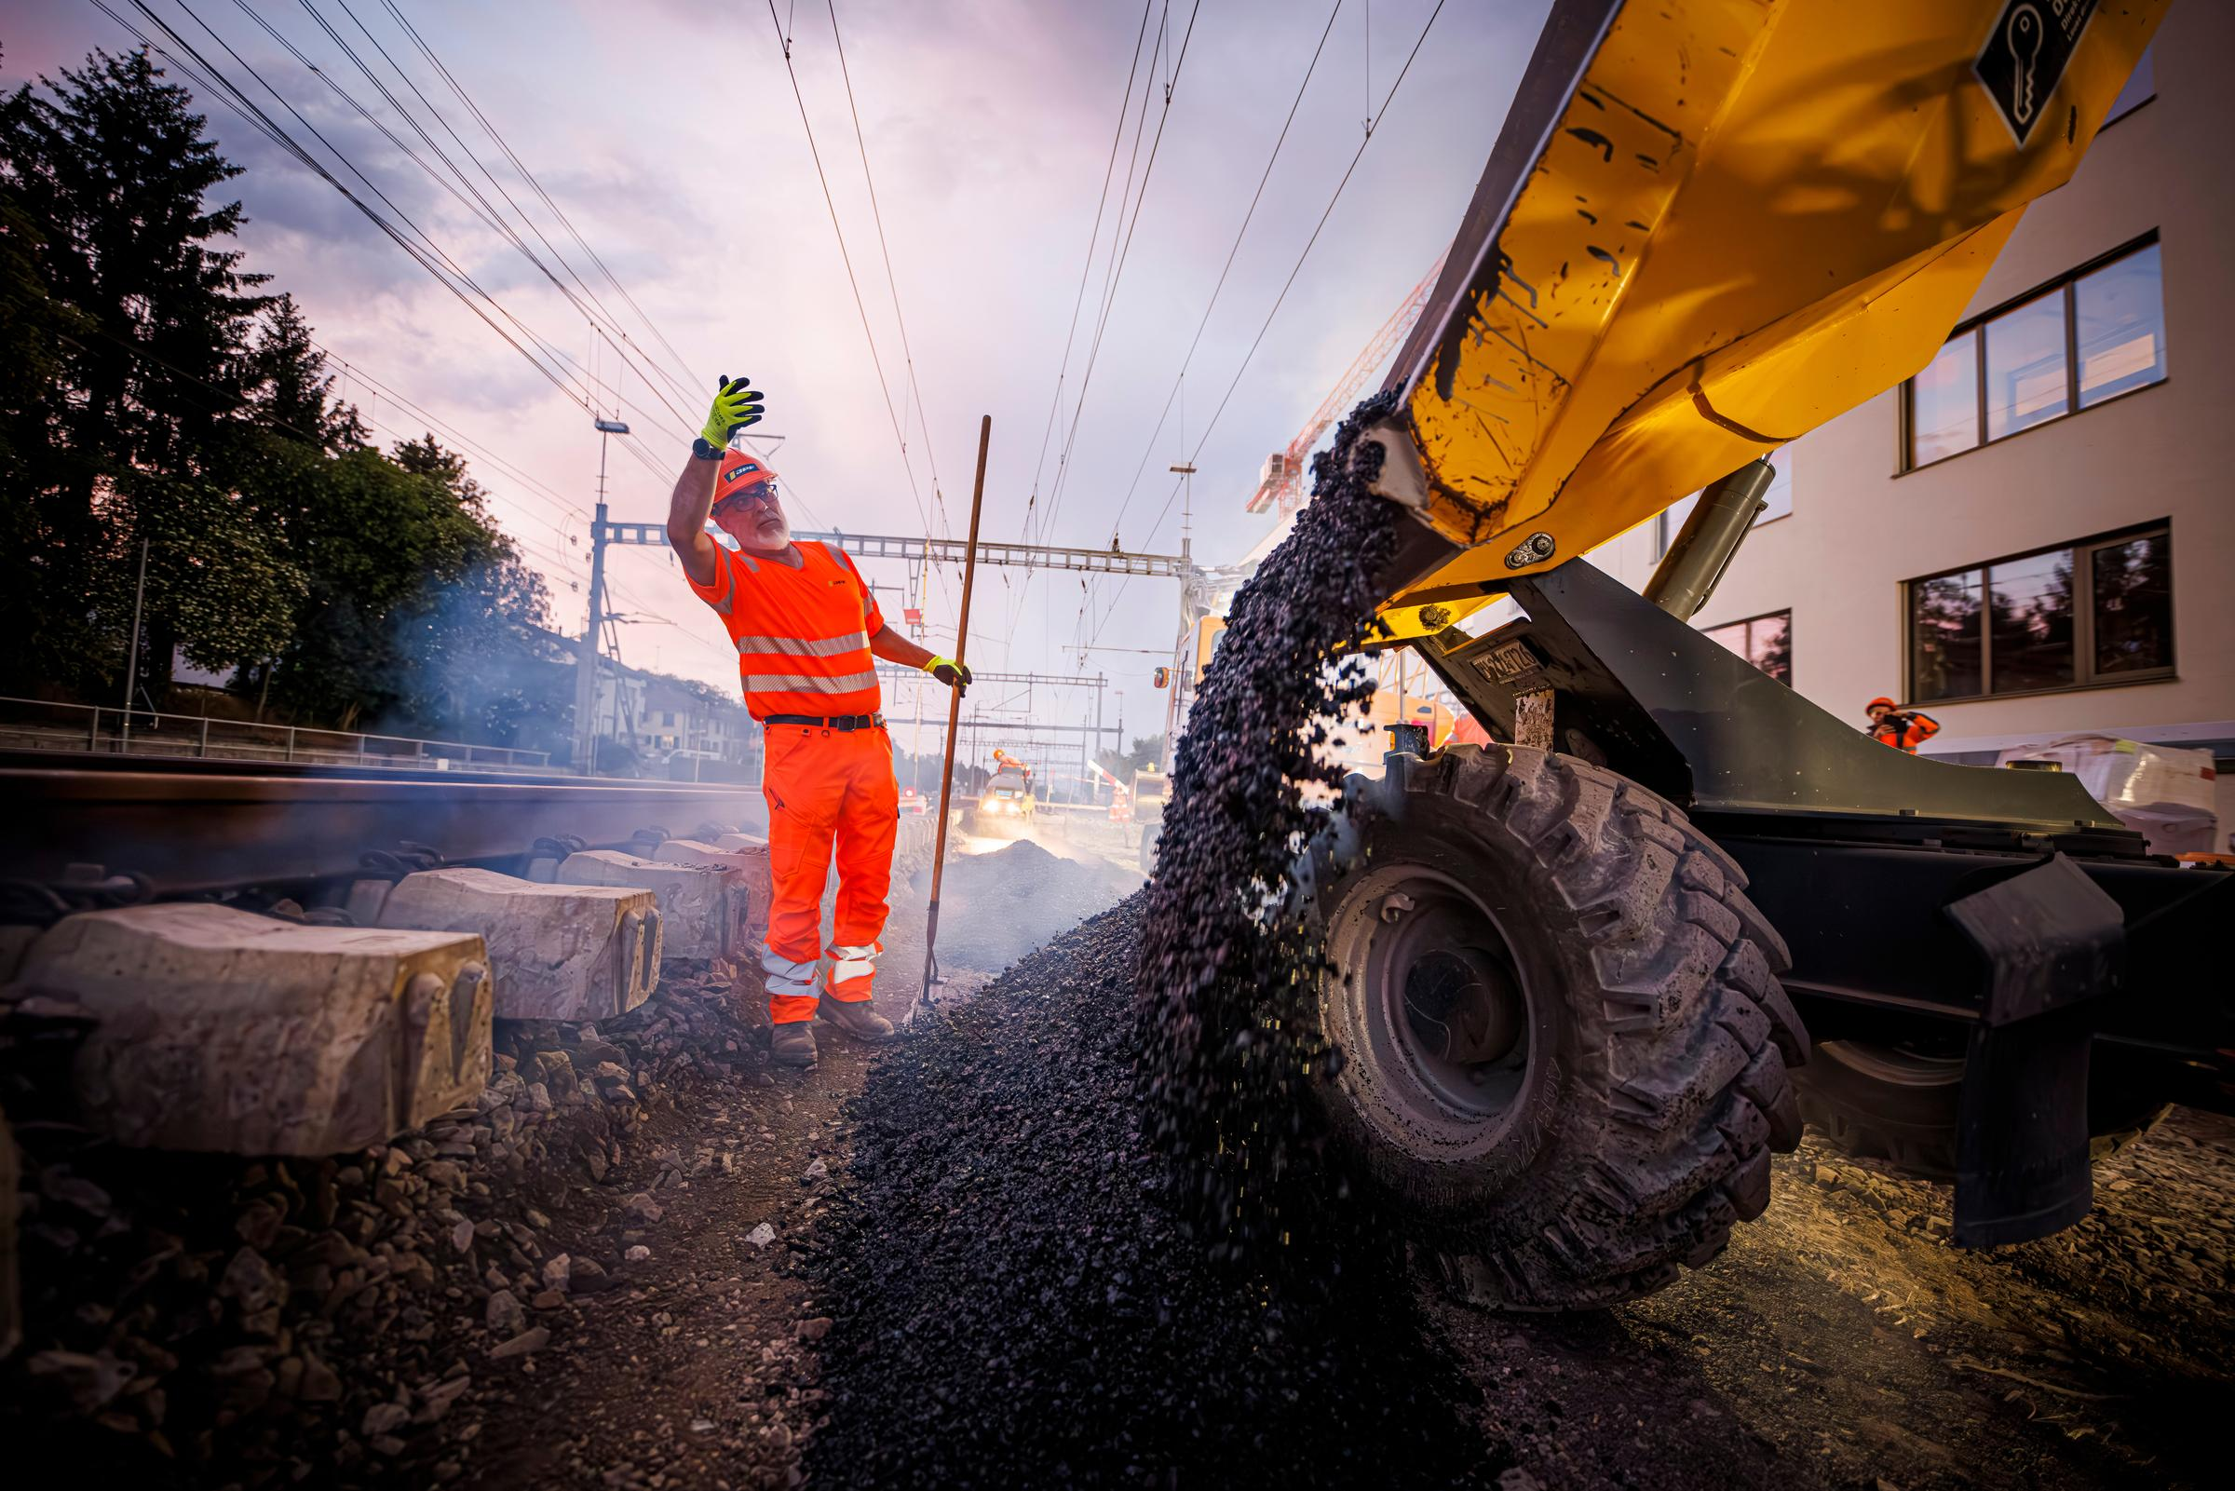
Intervall Vicious cycle
Daniel Eckenstein
25.11.2025

Slide 2
Interval – think tradeoffs and vicious cycle and connect the boxes…
Traffic increase
Less time for intervals
Higher infra
wear & tear
Rarer intervals
Shorter intervals
Increasing
work needs
Inefficient use of personel & machinery
Postponing works
Increasing interval need
Increasing finance needs
Work backlog increase
Scarce finances

